Slide 1
Significant of Earthquakes happens using Data Science technique
BHARATHI S - 211418104040 GUIDED BY
VASUNDHARA G- 211418104305 Mrs.JENNIFER GNANADEEPAM B-211418104065 Associate Professor

Slide 2
introduction
An earthquake is the shaking of the surface of the Earth resulting from a sudden release of energy in the Earth's lithosphere that creates seismic waves.
At the Earth's surface, earthquakes manifest themselves by shaking and displacing or disrupting the ground. So predicting the factors of an earthquake is a challenging job as an earthquake does not show specific patterns resulting in inaccurate predictions.
Techniques based on machine learning are well known for their capability to find hidden patterns in data. The machine learning model is built based on the past data related to earthquakes where the model can learn the pattern from the data and takes the consideration of the factors. The factors which are taken into consideration are the pre-processed data that is the dependency of the factors are checked in accordance with earthquake.
Comparison of machine learning algorithms are done for better prediction and performance metrics are also calculated an evaluated.

Slide 3
LITERATURE SURVEY
AUTHOR | METHODOLOGY | MAJOR FINDINGS
David P.Sahara, L.S.Heliani, S.Rasyid(2021) Earthquake Early Warning System | N-chech algorithm | Determine the earthquake source parameters in real time.
S.Widiyantoro(2020) Implications for megathrust Earthquake | CNN-Convolution Neural Network | It capable to detect interfered events, 3d image location.
X.Zhang,J.Zhang,C.Yuan,S.Lin, Z.Chen and W.LI(2020) Locating Induced Earthquake with a network of seismic station | CNN-Convolution Neural Network | Prediction of intensity measurements of ground shaking.
D.Jozinovic,A.Lomax, I.Stajduhar And A.Michelini(2020) rapid prodection of Earthquake ground shaking | CNN-Convolution Neural Network | It performs well when noise only data were included.
O.M.Saad and Y.Chen(2020) Earthquake detection and p-wave arrival time | Capsule NeuralNetwork(CapsNet) | It detect false alarm and many micro earthquake with small magnitude. CapsNet detects earthquake and release false alarm with a detection accuracy of 85.65.

Slide 4
Problem Statement
The goal is to develop a machine learning model for earthquake Prediction, to potentially replace the updatable Supervised machine learning Classification By predicting the result in The form of best accuracy by comparing the supervised algorithm.

Slide 5
Development Environment
TECHNICAL:
1.Software Requirements:
Operating System: Windows
Tool:Anaconda with Jupyter Notebook
2.Hardware Requirements:
Processor: Intel Core 15
Hard disk: Minimum 80 GB
Ram: 4GB

Slide 6
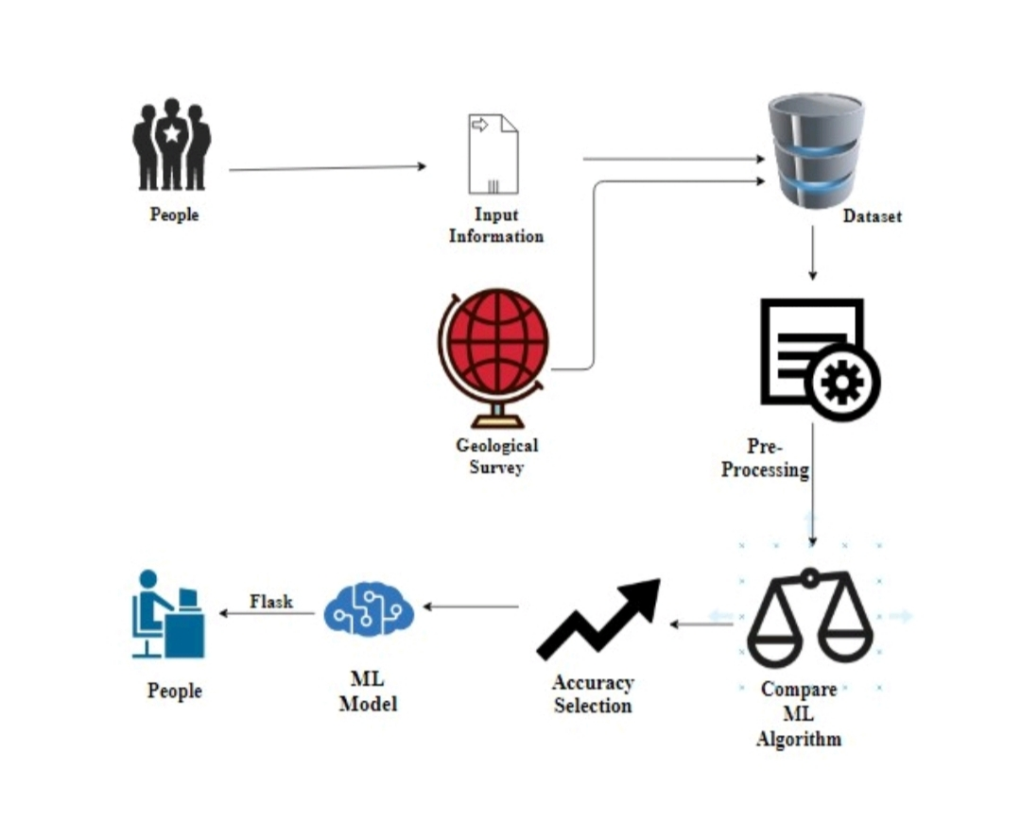
System Architecture
Input:
1.Latitude
2.Longitude
3.Magnitude
4.Time
5.Depth
6.Location Source
7.HorizontalError
8.DepthError
9.MagError
10.Magsource
Output:
0
(No Earthquake)
1
(if Earthquake occurs)

Slide 7
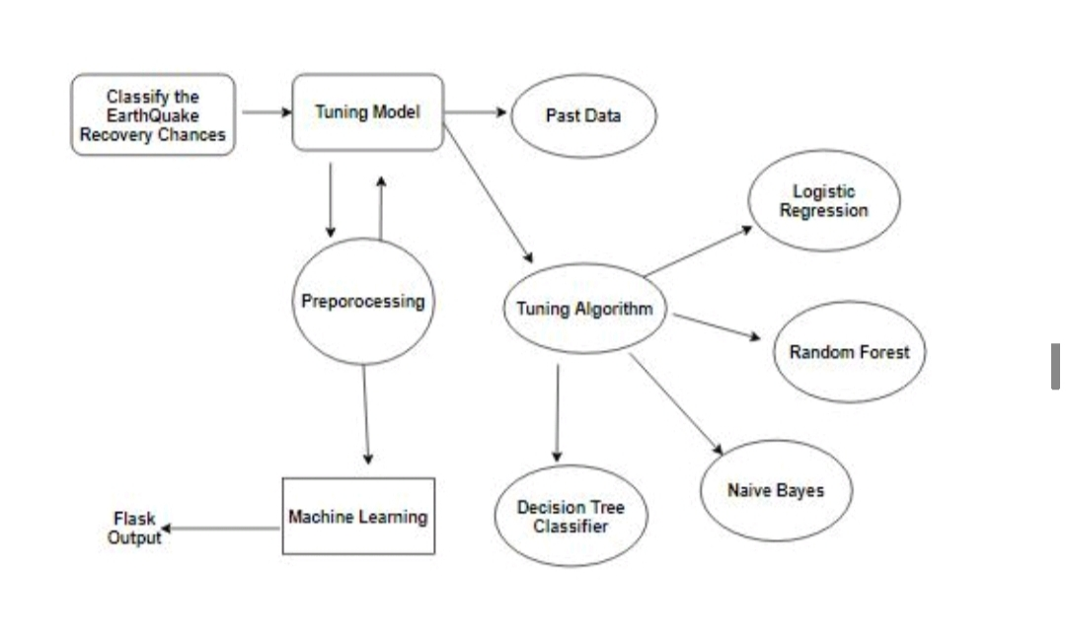
Entity Relationship Diagram (ERD)

Slide 8
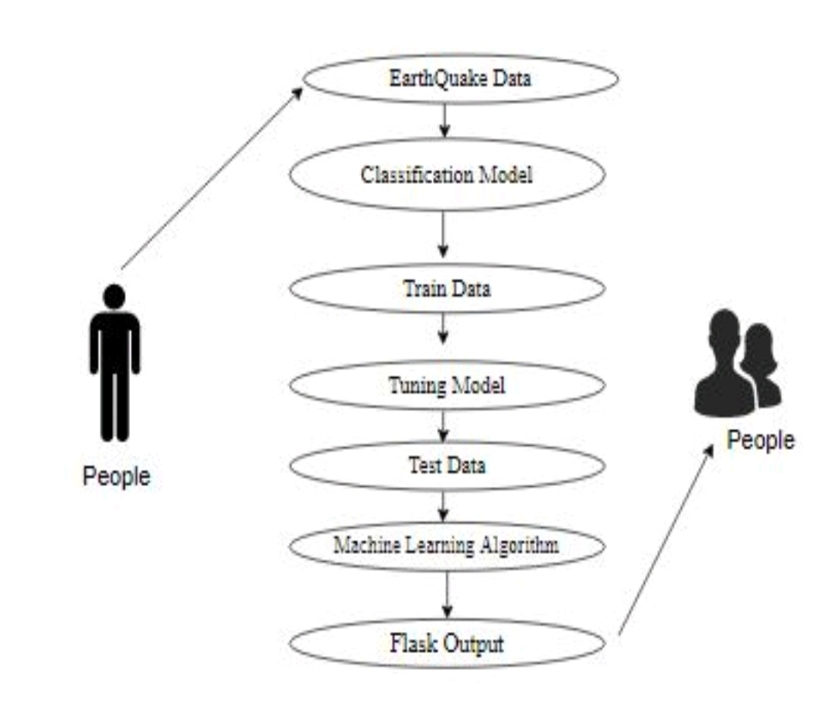
USECASE DIAGRAM:

Slide 9
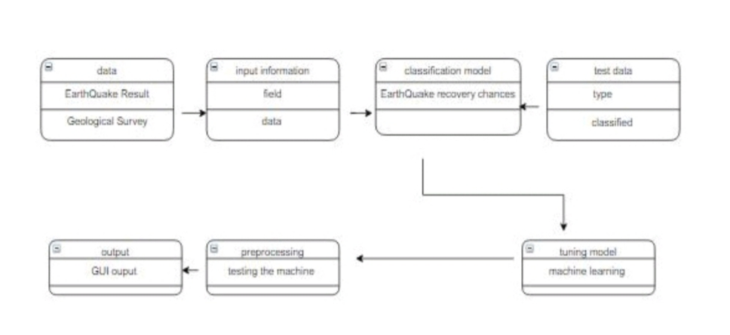
CLASS DIAGRAM:

Slide 10
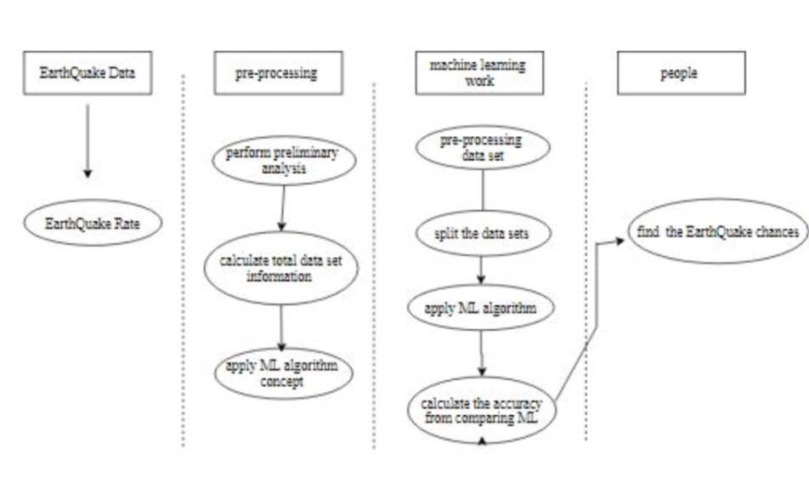
ACTIVITY DIAGRAM:

Slide 11
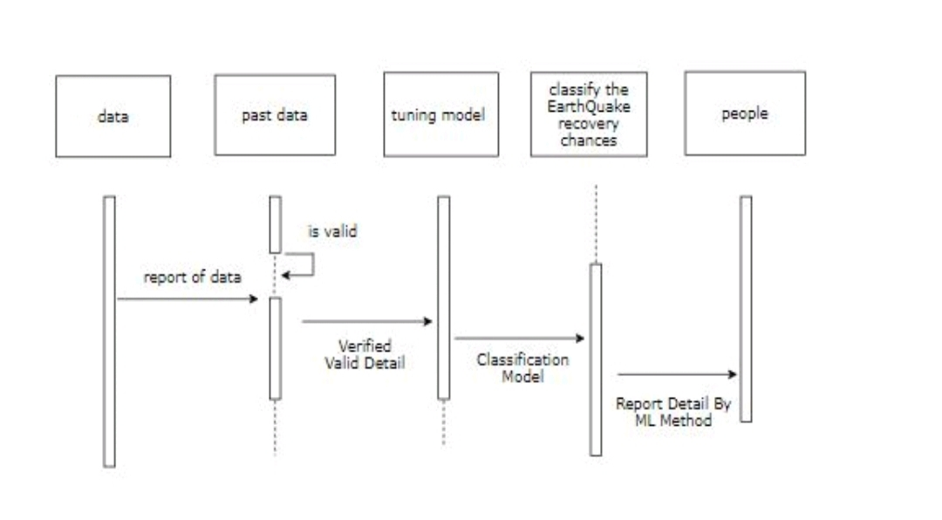
SEQUENCE DIAGRAM:

Slide 12
LIST OF MODULES
Data Pre-Processing
Data Analysis of Visualization
Comparing Algorithm with prediction in the form of best Accuracy result
Deployment Using Flask

Slide 13
Data Pre-processing
To finding the missing value, duplicate value and description of data type whether it is float variable or integer.
The sample of data used to provide an unbiased evaluation of a model fit on the training dataset while tuning model hyper parameters.
During the process of data identification, it helps to understand your data and its properties; this knowledge will help you choose which algorithm to use to build your model.
A number of different data cleaning tasks using Python’s Pandas library and specifically, it focus on probably the biggest data cleaning task, missing values and it able to more quickly clean data.

Slide 14
Data Validation/ Cleaning/Preparing Process
Importing the library packages with loading given dataset. To analyzing the variable identification by data shape, data type and evaluating the missing values, duplicate values.
A validation dataset is a sample of data held back from training your model that is used to give an estimate of model skill while tuning model's and procedures that you can use to make the best use of validation and test datasets when evaluating your models
Data cleaning / preparing by rename the given dataset and drop the column etc. to analyze the uni-variate, bi-variate and multi-variate process.
The steps and techniques for data cleaning will vary from dataset to dataset. The primary goal of data cleaning is to detect and remove errors and anomalies to increase the value of data in analytics and decision making.

Slide 15
Exploration data analysis of visualization
Data visualization is an important skill in applied statistics and machine learning. Statistics does indeed focus on quantitative descriptions and estimations of data.
Data visualization provides an important suite of tools for gaining a qualitative understanding.
This can be helpful when exploring and getting to know a dataset and can help with identifying patterns, corrupt data, outliers, and much more.
With a little domain knowledge, data visualizations can be used to express and demonstrate key relationships in plots and charts that are more visceral and stakeholders than measures of association or significance.

Slide 16
Comparing Algorithm with prediction in the form of best accuracy result
It is important to compare the performance of multiple different machine learning algorithms consistently and it will discover to create a test harness to compare multiple different machine learning algorithms in Python with scikit-learn.
It can use this test harness as a template on your own machine learning problems and add more and different algorithms to compare.
Each model will have different performance characteristics.
here we use 4 algorithms to compare.
Logistics Regression
Random Forest
Navie Bayes
Decision Tree Classifier
To accuracyng the result by comparing accuracy.

Slide 17
ALGORITHM
Logistic Regression
It is a statistical method for analysing a data set in which there are one or more independent variables that determine an outcome.
The outcome is measured with a dichotomous variable
The goal of logistic regression is to find the best fitting model to describe the relationship between the dichotomous characteristic of interest and a set of independent variables.
Logistic regression is a Machine Learning classification algorithm that is used to predict the probability of a categorical dependent variable.
In logistic regression, the dependent variable is a binary variable that contains data coded as 1 (yes, success, etc.) or 0 (no, failure, etc.).
In no words, the logistic regression model predicts P(Y=1) as a function of X. Logistic regression Assumptions:
InFor a binary regression, the factor level one of dependent variable Should represent the desired outcomes.

Slide 18
Random Forest Classifier
Random decision forests correct for decision trees’ habit of over fitting to their training set.
Random forest is a type of supervised machine learning algorithm based on ensemble learning.
The random forest algorithm combines multiple algorithm of the same type i.e. multiple decision trees, resulting in a forest of trees, hence the name "Random Forest".
The random forest algorithm can be used for both regression and classification tasks.The following are the basic steps involved in performi ng the random forest algorithm:
Pick N random records from the dataset.
Build a decision tree based on these N records.
Choose the number of trees you want in your algorithm.
The final values can be calculated by Taking the average of all the values predicted by all the trees in the forest.

Slide 19
Decision Tree Classifier
It is one of the most powerful and popular algorithm. Decision-tree algorithm falls under the category of supervised learning algorithms.
It works for both continuous as well as categorical output variables. Assumptions of Decision tree:
At the beginning, we consider the whole training set as the root.
Attributes are assumed to be categorical for information gain, attributes are assumed to be continuous.
On the basis of attribute values records are distributed recursively.
We use statistical methods for ordering attributes as root or internal node.
Decision tree builds classification or regression models in the form of a tree structure. It breaks down a data set into smaller and smaller subsets while at the same time an associated decision tree is incrementally developed.

Slide 20
Naive Bayes algorithm:
The Naive Bayes algorithm is an intuitive method that uses the probabilities of each attribute belonging to each class to make a prediction. It is the supervised learning approach you would come up with if you wanted to model a predictive modeling problem probabilistically.
Naive bayes simplifies the calculation of probabilities by assuming that the probability of each attribute belonging to a given class value is independent of all other attributes. This is a strong assumption but results in a fast and effective method.
The probability of a class value given a value of an attribute is called the conditional probability. By multiplying the conditional probabilities together for each attribute for a given class value, we have a probability of a data instance belonging to that class.
To make a prediction we can calculate probabilities of the instance belonging to each class and select the class value with the highest probability.
Naive Bayes is a statistical classification technique based on Bayes Theorem.

Slide 21
It is one of the simplest supervised learning algorithms.Naive Bayes classifier is the fast, accurate and reliable algorithm. Naive Bayes classifiers have high accuracy and speed on large datasets.
Naive Bayes classifier assumes that the effect of a particular feature in a class is independent of other features. For example, a loan applicant is desirable or not depending on his/her income, previous loan and transaction history, age, and location.
Even if these features are interdependent, these features are still considered independently. This assumption simplifies computation, and that's why it is considered as naive. This assumption is called class conditional independence.

Slide 22
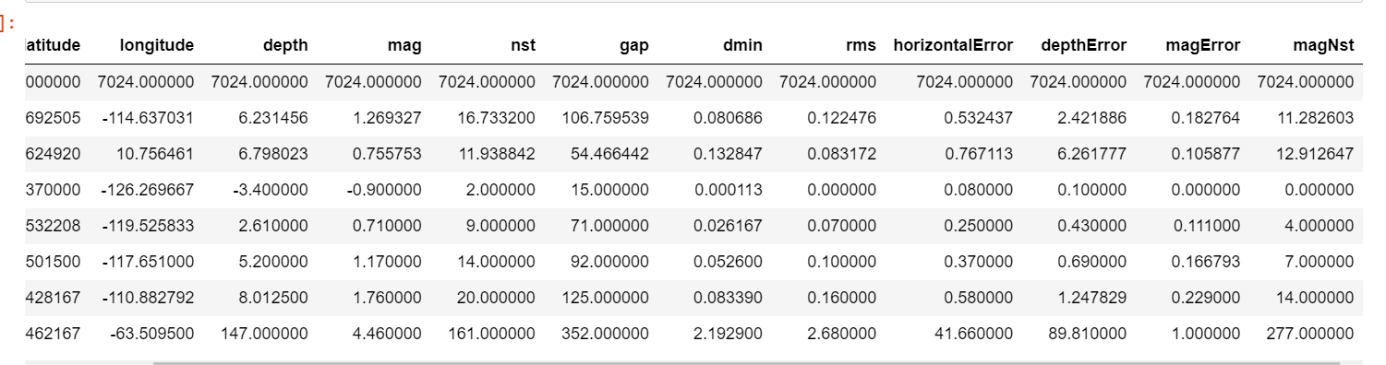
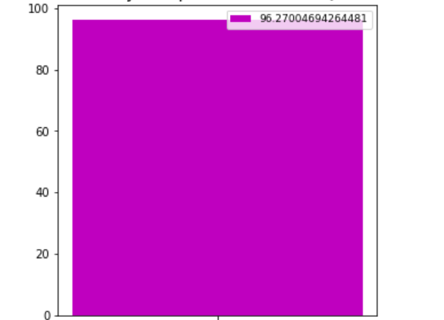
PERFORMANCE ANALYSIS
Performance analysis for Earthquake prediction
High Accuracy for Earthquake Predcition

Slide 23

SCREEN SHOTS

Slide 24


Slide 25
CONCLUSION
The analytical process started from data cleaning and processing, missing value, exploratory analysis and finally model building and evaluation. The best accuracy on public test set is higher accuracy score is will be find out. This application can help to find the Prediction of Earth Quake.

Slide 26
REFRENCES
[1]C. Pratama, David P. Sahara, L. S. Heliani, S. Rasyid,Zharfan Akbar, Faiz Muttaqy, and Ajat Sudrajat(2021),” Earthquake Early Warning System Using Ncheck and Hard-Shared Orthogonal Multitarget Regression on Deep Learning”doi: https://doi.org/10.1109/LGRS.2021.3066346.
[2]S. Widiyantoro et al., (2020)“Implications for megathrust earthquakes and tsunamis from seismic gaps south of Java Indonesia,” Sci. Rep., vol. 10,no. 1, pp. 1-11Dec.2020,doi:10.1038/s41598-020-72142-z.
[3]X. Zhang, J. Zhang, C. Yuan, S. Liu, Z. Chen, and W. Li,(2020) “Locating induced earthquakes with a network of seismic stations in Oklahoma via a deep learning method,” Sci. Rep., vol. 10, no. 1, pp. 1—12, Dec. 2020,doi: 10.1038/s41598-020-58908-5.
[4]D. Jozinovi ́c, A. Lomax, I. Štajduhar, and A. Michelini, “Rapid predic-tion of earthquake ground shaking intensity using raw waveform data and a convolution Neural network,”2020,arXiv:2002.06893.[Online].Available: https://arxiv.org/abs/2002.06893

Slide 27
[5]M. P. A. van den Ende and J. P. Ampuero, “Automated seismic source characterization using deep graph neural networks,” Geophys. Res. Lett.,vol. 47, no. 17, pp. 1—11, Sep. 2020, doi: 10.1029/2020GL088690
[6]O. M. Saad and Y. Chen,(2020) “Earthquake detection and P-wave arrival time picking using capsule neural network,” IEEE Trans. Geosci.Remote Sens., early access, Sep. 28, 2020, doi:
10.1109/tgrs.2020.3019520.
[7] S. M. Mousavi, W. L. Ellsworth, W. Zhu, L. Y. Chuang, andG. C Beroza,(2020)“Earthquake transformer—An attentive deep-learningmodel for simultaneous earthquake detection and phase
picking,” NatureCommun., vol. 11, no. 1, pp. 1—12, Dec. 2020, doi: 10.1038/s41467-020-17591-w.
[8] Z. E. Ross, Y. Yue, M. Meier, E. Hauksson, and T. H. Heaton,(2019)“PhaseLink: A deep learning approach to seismic phase association,”J. Geophys. Res., Solid Earth, vol. 124, no. 1,pp.856—869,Jan.2019,doi:10.1029/2018JB016674.

